Slide 1
Cloud Club ☁️
Cloud Computing

Slide 2

Cloud Club ☁️
Discord
https://discord.gg/V5H5Ex5Y7Y

Slide 3
Please join the student organization
Link can be found in discord

Slide 4
Schedule

Slide 5
Spring 2023 Schedule (tentative)
January 23, 2023
Discuss Cloud computing
Hands-on-experience (AWS EC2)
February 6, 2023
Discuss Serverless computing
Hands-on-experience (AWS Lambda)
February 20, 2023 ⭐️
Discuss Infrastructure as Code (IaC)
Hands-on-experience (AWS Cloudformation)
March 6, 2023
Continuous Integration & Continuous Deployment (CI/CD)
Hands-on-experience (GitHub Actions)
March 20, 2023
Discuss Docker
Hands-on-experience (Docker)
April 3, 2023
Recap on everything discussed
Project presentations
Notes:
⭐️IAC day is super awesome. Encourage everyone to attend this meeting.
Project Presentations is simply an opportunity for members to showcase any cloud-based projects they have built.

Slide 6
Cloud Computing

Slide 7
Why cloud computing?
No more hardware limitations
Scalability
No need to worry about running out of storage
Can be cheaper than maintaining hardware
no need to use a computer to host static files
Ease of access
Ability to stand up a server in minutes

Slide 8

Examples of cloud computing
Facebook
Apple
Amazon
Netflix
Google
Notes:
Obvious examples of cloud storage:
Google Drive
Google Photos
Less obvious:
Netflix

Slide 9

Cloud Computing with AWS
Amazon Web Services: Elastic Compute Cloud (EC2)
* Note there are other (more advanced) computing services within AWS.

Slide 10
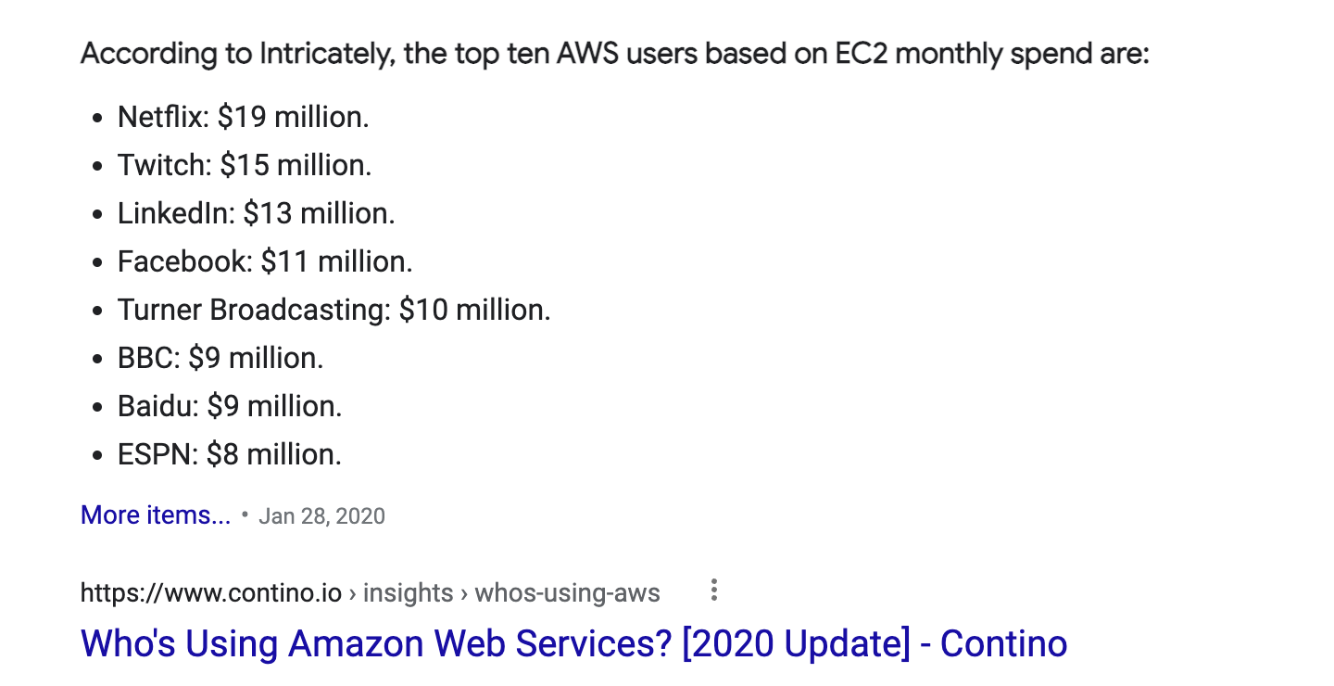
Examples of EC2 usage

Slide 11
Virtual Private Clouds (VPC) & Security Groups

Slide 12

What is a VPC?
A basic cloud concept
Isolate your cloud resources in an internal “cloud” (network)
Enables complete control over public access to your cloud resources
An AWS service in itself

Slide 13
What are Security Groups?
Simple version of VPC
Used to enable traffic to either a VPC or an EC2 Instance
Example: Hosting a server on port 8443 on an EC2 will not work without a security group.

Slide 14
Hands-on experience

Slide 15
Hands-on Experience
AWS EC2
Notes:
Demo these steps:
Log into the AWS console
Navigate to the EC2 console
Create a SSH key
Create an EC2 instance
Create the needed security groups
SSH into instance
Launch a webserver of some kind on the instance
Connect to the instance

Slide 16
Hands-on Experience
AWS EC2
Log into the AWS console
Navigate to the EC2 console
Create a SSH key
Create an EC2 instance
Create the needed security groups
SSH into instance
Launch a server of some kind (i.e., nodejs webserver, game server, whatever you want)
Connect to the instance
Verify that the server is running (and publicly accessible)

Slide 17
Hands-on Experience
Remember to shutdown (or just delete) your EC2 instance.
* EC2 instances are one of the more expensive AWS resources

Slide 18
“Homework” for the next meeting
Join the Discord
Officially join the student organization
URL in #annoncements channel on Discord

